Slide 1
MACHINE LEARNING
Session – 2
Date – 14th May, 2022

Slide 2
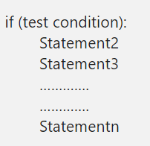
Python If Statement
The Python If statement is one of the most useful decisions making statements in real-time programming. Python If statement allows the compiler to test the condition first, depend upon the result, it executes the code block. while a given test condition is true, then only the code within the if block executes.
The if statement in Python Programming has a simple structure:
When the test condition in the Python If statement is true, Statement1, Statement2, ……., Statementn will execute. Otherwise, all too them will skip. Let us see the flow chart for a better understanding.

Slide 3
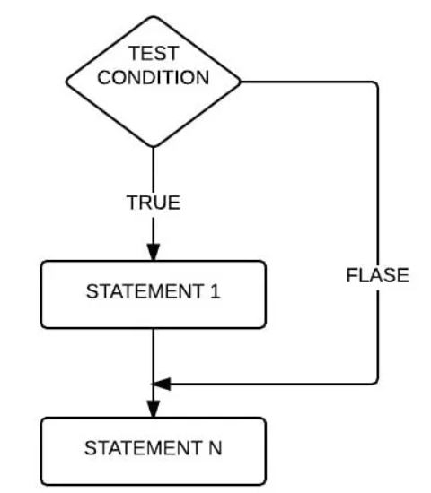
Python If Statement Flow Chart

Slide 4
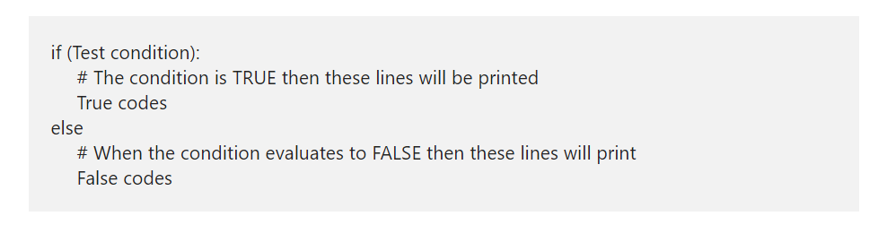
Python If Else Statement
The Python If Else Statement is an extension to the If (which we discussed in the earlier post). The If condition will only execute the code block when the given condition is true and when the condition is false, it will not execute the code.
In real-world, it would be nice to execute something when the expression fails. To do so, If condition is used and here, the Else block will run some code when the condition fails. The syntax of the Python If Else Statement is.
When the test condition present in the above Python If else structure is evaluated to true, True statements executed. When it return false, False code executed.

Slide 5
Python Nested If
Python Nested If Statement means to place one If inside another If Statement. Python If Else statement allows us to print different statements depending upon the expression result (TRUE, FALSE). Sometimes we have to check further even when the condition is TRUE. In these situations, we can use the Python Nested IF statements, but be careful while using it.
In the Python nested if statement example, every person is eligible to work if he is 18 years old or above. Else he is not qualified. However, companies won’t offer a job to every person. So, we use another If condition, also called Python Nested If Statement, to check his education qualifications or any specific company requirements.

Slide 6
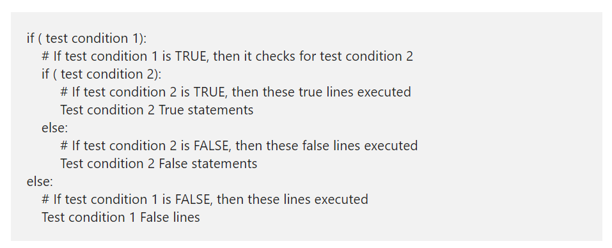
Python Nested If Statement Syntax
The Python Nested If Statement Syntax is

Slide 7
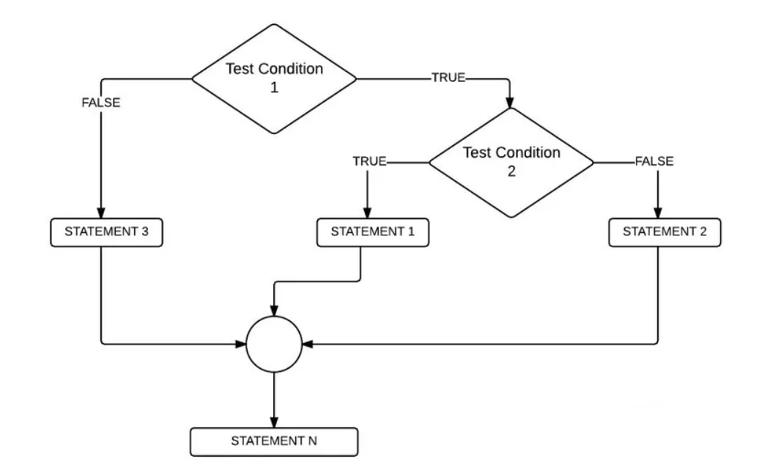
Nested if Flow Chart

Slide 8
Python elif Statement
The Python elif Statement also called as the Else If and it is very useful when we have to check several conditions. Apart from this Python elif, we can also use the Nested If to achieve the same. However, as the number of conditions increase, the Nested If else complexity will also increase. Let us see the syntax of the same.

Slide 9
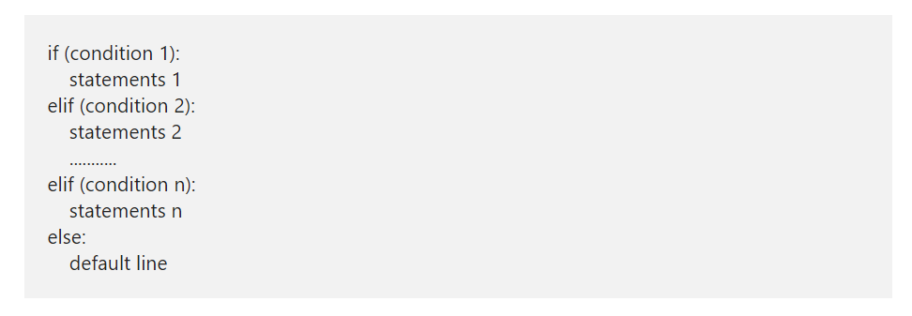
Python elif Syntax
The syntax of Python elif or else if statement is

Slide 10
Python elif Syntax Contd.
The Python Elif or else if statement handles multiple lines effectively by executing them sequentially. It means Python elseif or elif will check for the first condition, if the condition is TRUE then it will execute the statements present in that block.
If the condition is FALSE then Python elseif will check the Next one (Elif conditional statement) and so on. There will be some situations where condition 1, condition 2 is TRUE, for example:
x= 20, y=10
Condition 1: x > y # TRUE
Condition 2: x != y # TRUE
In these situations, block of code under the Condition 1 will be executed. Because Python elif conditions will only be executed if its previous if statement (else) fails.

Slide 11
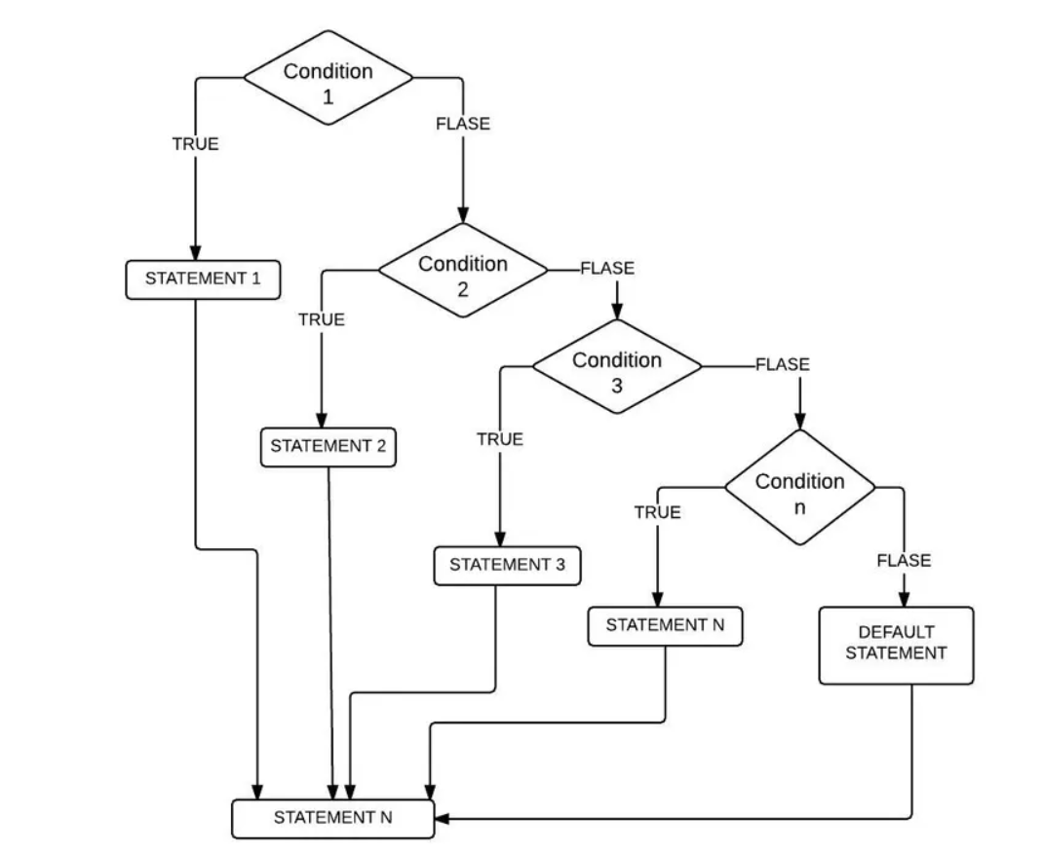
Elseif Statement Flow Chart

Slide 12
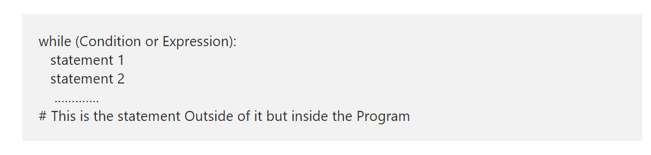
Python while Loop
The Python while Loop is used to repeat a block of statements for given number of times, until the given condition is False. A while loop in Python start with the condition, if the condition is True then statements inside it will be executed. If the given condition is false, it won’t execute at least once, which means, it may execute zero or more time and the syntax of it is:
The Python While Loop Syntax is as follows:

Slide 13
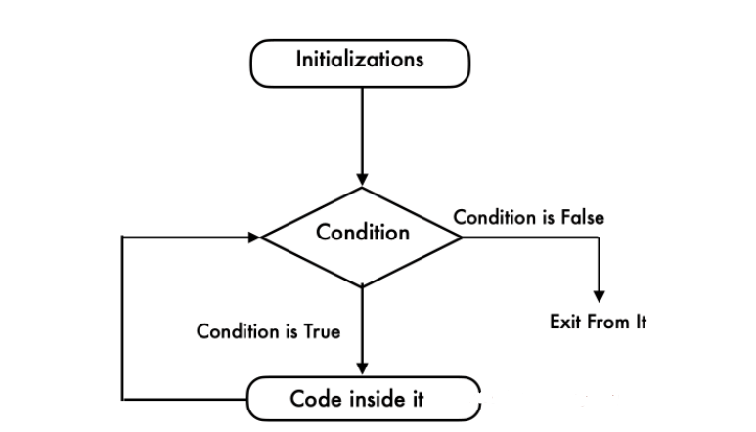
Python while Loop Flow Chart
This flow chart will explain you Visually and perfectly

Slide 14
Python while Loop Flow Chart Contd.
Python while loop will check for the condition at the beginning of it.
If the condition evaluates to True then it will execute the code inside it.
Next, we have to use Arithmetic Operator inside the Python while loop to increment and decrement the value.
After the value increments, it will again check the expression. As long as the condition is met, the statements in it will be executed.
If the expression becomes False then it will exit from it.

Slide 15
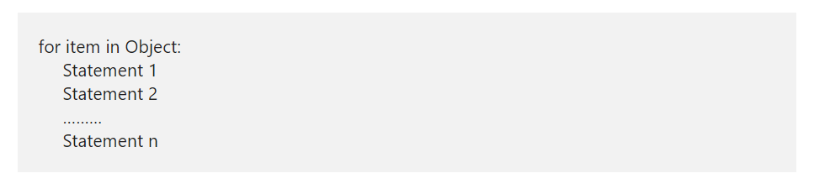
Python For Loop
The Python For Loop is used to repeat a block of statements until there are no items in the Object may be String, List, Tuple, or any other object. Let us see how to write the Python For Loop, range, and the else part with practical examples. Let us see the syntax of it, prior to getting into the details:
The syntax of the Python For Loop in is as follows:

Slide 16
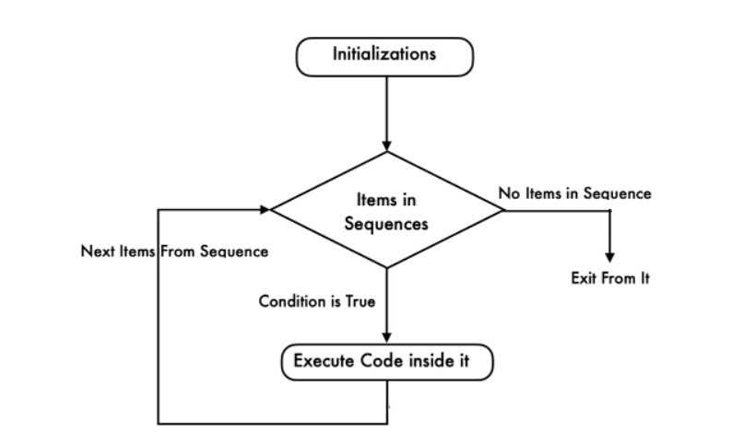
Python For Loop Flow Chart

Slide 17
Python For Loop Flow Chart Contd.
The execution process of the for loop in python is:
Initialization: We initialize the variable(s) here. Example i=1.
Items in Sequence / Object: Compiler will check the items in Objects. Example, individual letters in String word. If there are items in sequence ( True) then it will execute the statements within it or inside. If there is no item in sequence ( False) then it will exit.
After completing the current iteration, compiler will traverse to next item.
Again it will check the new items in sequence. As long as the items in sequence, the statements inside it will be executed.

Slide 18
Python break Statement
The Python break statement is very useful to exit from For, While and Nested Loops. While executing these code blocks, if the compiler finds this inside them, the compiler will stop executing the code inside it and exit immediately from the iteration.
For example, we have 5 lines of code inside the loop and we want to exit from it when certain condition is True otherwise, it has to execute them. In these situations we can place the Python Break statement inside the If condition.
If the condition is True then compiler will execute this statement. It means, the Python break Statement will exit the controller from the loop completely. Otherwise, it will execute all block of code.

Slide 19
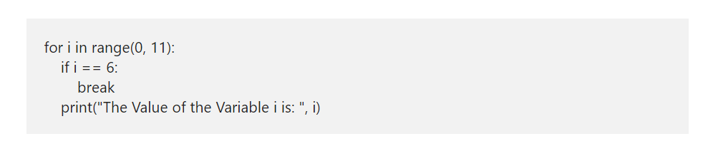
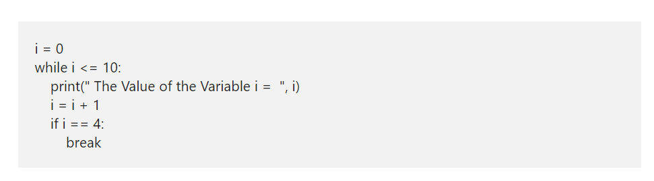
Python break Statement in For and While loop

Slide 20
Python continue
The Python continue statement is another one to control the flow of loops. Similar to Break statement, this Python continue statement is used inside For and While Loops. While executing these iterables, if compiler find this statement inside them, then compiler will stop the current iteration and starts the new iteration from the beginning.
For example, we have 10 statements inside the loop. And we want to skip executing the last 5 (statement6 — 10) when a certain condition is True or else it has to execute all the 10 statements inside a loop. In these situations, we place the condition after the 5th followed by the Python continue statement. If the condition is True then it will stop executing statement6 to 10 otherwise, it will execute lines 1 to 10.

Slide 21
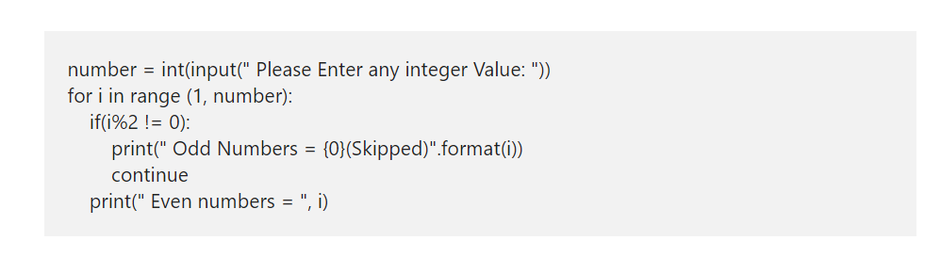
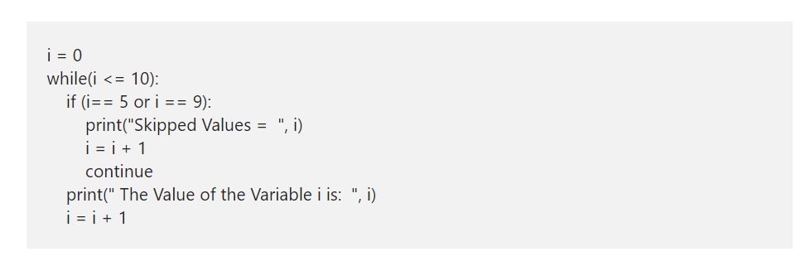
Python continue Syntax

Slide 22
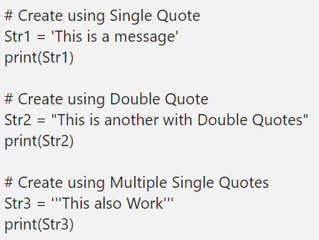
Python String
The Python String is nothing but a sequence of characters. In this section, we discuss how to create a String, accessing the individual characters (items), iterating the characters. Also, show you slicing String in Python programming language.

Slide 23
Access Python String items
We can access the elements in a Python String using indexes. Using an index, we can access each item separately. Index value starts at 0 and ends at n-1, where n is the length. For example, if the length is 5, the index starts at 0 and ends with 4. To access 1st value, use name[0] and to access the 5th value, then use name[4].
If you are using the Negative index numbers, it starts looking for items from right to left

Slide 24
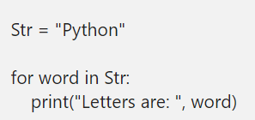
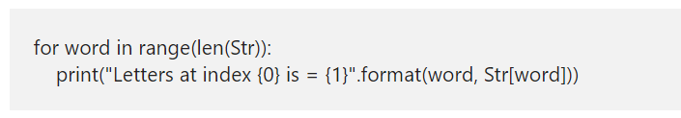
Iterate String
The Python For Loop is the most common way to traverse the characters or items in a string. This code helps us to iterate the str, and prints each character present in the str.
The above-specified code works nicely to print the characters inside it. However, to change the individual item, we need the Python index position also. To fix this, we have to use the range function along with for loop

Slide 25
string concatenation
Joining or combining more than one is called as the Python string concatenation or concat. There are multiple ways to concat.
We can use + operator to join more than one.
By placing more than one literal, joins them automatically.
Placing more than one inside the one and closed parentheses ()
* operator is repeating the sentence for a given number of times. Here it is three times.

Slide 26
Python String Slice
In python String Slice, the first integer value is the index position where the slicing start and the second is where the slicing end, but it does not include the content at this index position. For instance, if we define stritem[1:4], then string slicing starts at index position 1 and ends at index position 3 (not 4).
If you omit the first index, the slicing starts from the beginning.
If you omit the second argument, Slicing starts from the first position and continues to the last.
And, If you are using the Negative numbers as an index, the slicing starts from right to left.

Slide 27
What is a List in Python?
The Python List is one of the most useful sequences in real-time. A Python list is a sequence of multiple values in an ordered sequence. Unlike Strings, it allows us to store different types of data such as integer
An object that contains no values or elements is empty and placing a square bracket creates an empty list in python language.
ListName = []
IntegerList = [1, 2, 3, 4, 5]
StringList = [‘apple’, ‘Orange’, ‘Grape’, ‘Mango’]
MixedList = [‘apple’, 2, 3.50, ‘Mango’]
Python Lists sequentially store data (ordered). So, we can access the elements with the help of indexes. Moreover, using indexes, we can access or alter/change each item present in it separately. The syntax to access items is
ListName([IndexNumber])

Slide 28
Insert items into Python List
append(x): The append method adds item x at the end.
insert(i, x): The insert method inserts the specified item x at position i.
extend(New_List): The extend method adds all the elements in New_List at the end.
Python List Slicing

Slide 29
More List Function
Copy()
Clear()
Sort()
Reverse()
Index(element)
Count(element)
Sum(list)

Slide 30
Python List Comprehensions
A = [1, 2, 3, 4, 5]
DoubleA = [I * 2 for I in A]
B = [y for y in a if y%2 ==0 ]
C = [n for n in range(1,150) if n%2 == 0 if n%5 == 0]
D = [[I * j for j in range(1,11)] for I in range(2,4)]

Slide 31
Python Tuple
The Python Tuple is almost similar to a List except that these are immutable, and Lists are mutable. It means Once we declare the Python Tuple, we cannot change the values or items inside it, something like Constant keyword in other programming languages.
A Python Tuple is a sequence of multiple values in an ordered sequence. Tuples are declared using Open and Closed Parenthesis ( ). Unlike Strings, Python Tuple allows us to store different types of data such as integer, float, string, etc.
To declare an empty Tuple in Python that contains no values, use TupleName = ().
StringTup = (‘apple’, ‘Orange’, ‘Grape’, ‘Mango’) is a string tuple that contains four string values.
MixedTup = (‘apple’, 2, 3.50, ‘Mango’) is a mixed one that contains one integer, one float, and two integer values.
NestedTup = (‘Gateway’, ‘Tutorial’, (1, 2, 3) ) is an example of one inside another (Nested).
ListTup = (‘Py’, ‘Tutorial’, [1, 2, 3] ) is an example of List inside it.

Slide 32
Python Tuple Methods
Sum(tuple)
Len(tuple)
Min(tuple)
Max(tuple)
Sorted(tuple)
Index(element)
Count(element)
Tuple(list)

Slide 33
Python Set
A Python set data type is similar to Lists. However, it does not accept duplicate items (unique values). It is an unordered collection of zero or more items, which are unindexed (no index position).
Python Sets allows mutable items, so adding and removing items is very easy. However, slicing is not possible because of no index. Generally, Python sets are very useful to perform mathematical operations like Union, Intersections, comparisons, and differences.
In Python, it can be created by placing the required items inside curly braces or using the set() function without any arguments. It allows you to place different kinds of data type items like integer, string, etc., in a single one. The following is the available list of ways to declare them.
S1 = {}

Slide 34
Insert items in set
add(x): Add one item to the existing one in Python.
update(): Add multiple items to the existing one.

Slide 35
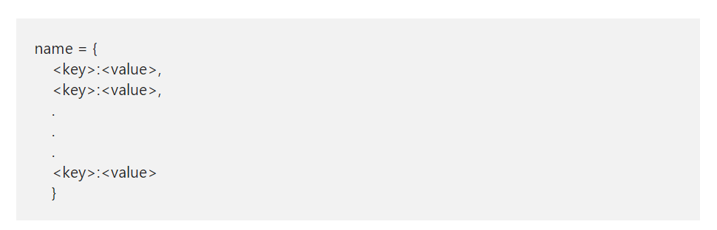
Python Dictionary
A Python Dictionary is a collection which is unordered, changeable, and indexed. Unlike a string, it is mutable. So, the Python dict can expand or sink.
We can declare a Python Dictionary by simply placing empty parenthesis, or using the dict(). The syntax for declaring a dictionary

Slide 36
How to Access Python Dictionary items?
Though, dictionary is an unordered collection, we can access the values using their keys. It can be done by placing the key in the square brackets or using get function. If we access non-existing one, the get function with return none. Whereas placing the key inside a square brackets method throw an error
Dname[key] or Dname.get(key)

Slide 37
Insert and Update Python Dictionary items
Remember, dicts are mutable so, you can insert or update any element at any point in time. Use below syntax to insert or update values.
DName[key] = value
If a key is present, it updates the value. If DName does not have the key, then it inserts the new one with the given.
Pop(element)

Slide 38
More functions for dictionary
Da.values()
Da.key()
The copy functions shallow copy the given dict into a completely new one. You can also place a it inside a list.
The pop method removes the value at a given key, and prints the removed item. The Python pop item removes the last inserted item (key, value pair).

Slide 39
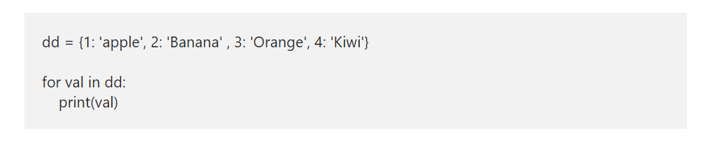
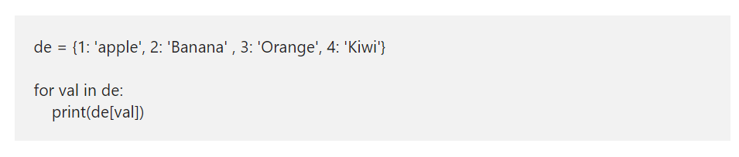
Dictionary Contd.

Slide 40
Python Dictionary Methods
clear() removes all the elements.
copy() shallow copy.
fromkeys() returns a new one, where keys start from a sequence and equal to values.
get() value of a Given Key.
items() returns a list containing the items (keyvalue pairs)
keys() Prints a list of keys.
pop() remove and print the item of a given key. Use to delete.
popitem() removes and prints the last inserted keyvalue pair.
setdefault() – If the given key is present, it returns its value. If not, this function inserts a key with a given value and prints that.
update() updates the KeyValue pair.
values() returns the list of all the values.

Slide 41
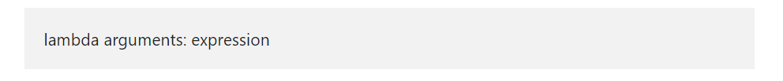
Python lambda Function
The Python lambda function is anonymous means, a function without a definition keyword and name. To create this function, we have to use the Python lambda keyword and the syntax of the expression is
This lambda function accepts any number of arguments. However, it takes only one expression. For instance, Python lambda a, b: a + b. Here, a and b are the arguments accepted by the function, a + b is the expression.

Slide 42
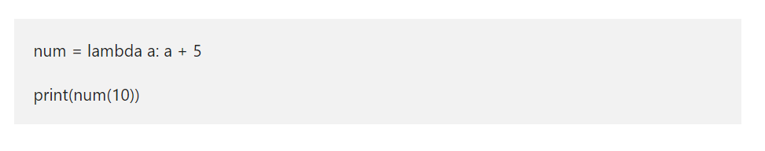
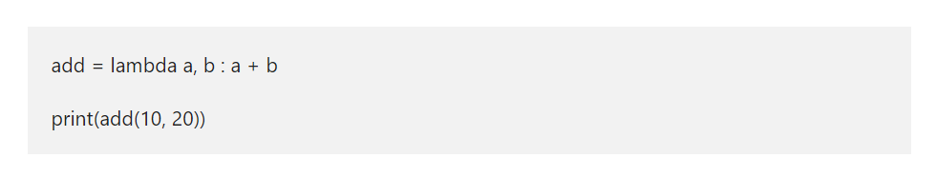
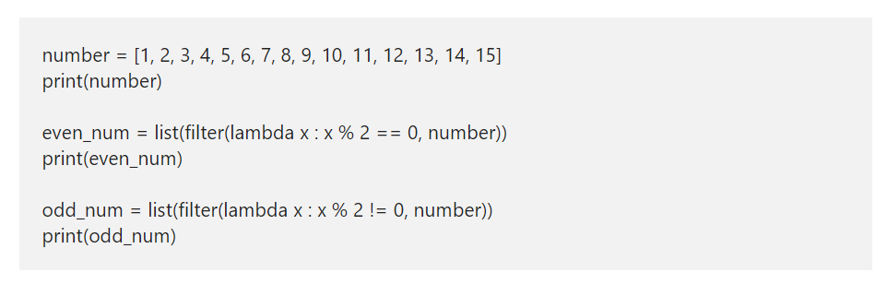
Python lambda Sum

Slide 43
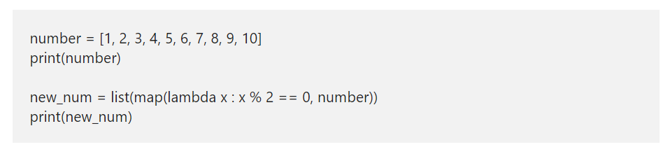
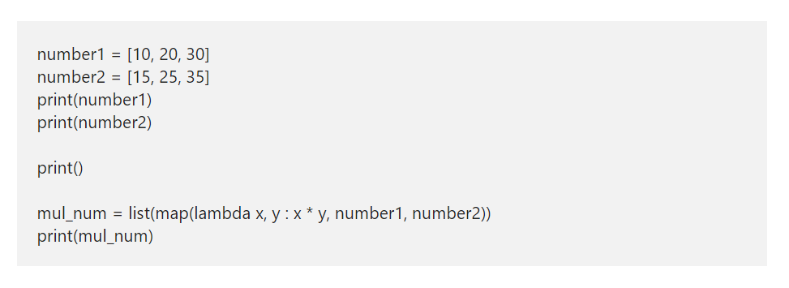
map lambda expressions Example
Unlike filter, map function takes each list item and returns both the True and False values. In this Python lambda map example, we used map method to return the Boolean value. It checks each individual value is divisible by 2 equals to 0. If true, it returns True. Otherwise, it returns false.

Slide 44
Functions in Python
Python Function is a piece of code or any logic that performs the specific operation. We already saw some methods until now, and you may not notice them. For instance, print(), factorial(), round(), etc., are few of the built-in functions in Python programming language.
We don’t have to bother about the logic inside the Library or built in functions in Python Programming Language. In our previous articles, We used many library methods such as print(), factorial(), round() etc.
User Defined: Instead of relying on built-in, Python programming language allows us to create our own called as user defined functions. For example, if we want to implement some mathematical calculations, then put them in separate methods with the correct name. Then we can call that method multiple times.

Slide 45
Advantages of functions in Python
It helps to divide the large programs into small groups so that we can read the code, and debug the program faster and better.
Python Functions stop us from writing the same logic various times. We can bind the logic in one def and then call the same over and over.
Many persons can work on the same program by assigning different methods to each of them.
It encourages us to call the same method with different inputs over multiple times.

Slide 46
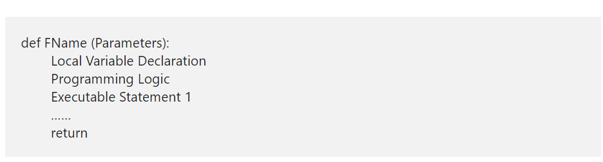
Python Define Functions Syntax

Slide 47
Python Define Functions Syntax Contd.
def: Keyword def is the introduction to the definition. Remember, the Python def keyword must immediately follow by the Name to define it.
FName: It can be any name you wish to give other than the system reserved keywords.
Parameters: Every python function accepts 0 or more parameters. It completely depends upon the user requirements.
Local Variable Declaration: Sometimes, we may need some temporary variable only for that particular method, then we can declare the local scope variables inside it. It is not compulsory, entirely depends upon user requirements. Remember, these variables are available to this particular method only, and we can’t access them outside.
Logic: Any mathematical or any code or calculations you need to implement in this particular func.
Executable Statement: Any print statements to print some data from this particular def.
return: This keyword is required to return something from the method. For example, returning the sum of two integers, etc.

Slide 48
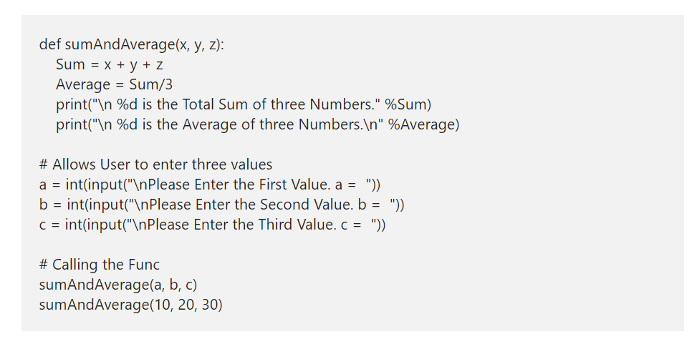
Example function

Slide 49
Types of Functions in Python
In real-time, a Python function may define with or without parameters, and a function may or may not return a value. It entirely depends upon the user requirement. In this article, we explain to you the types of functions in Python Programming language with examples.
In Python programming, as per our requirement, We can define the User defined functions in multiple ways. The following are the list of available types of functions in Python.
Python Function with no argument and no return value.
Function with no argument and with a Return value.
Python Function with argument and No Return value.
Function with argument and return value.

Slide 50
Python Iterator
An Iterator in Python is an Object which contains a countable number of values or elements. You can use this one to Traverse all those elements. The Python iterator uses the special methods called __iter__() and __next__() methods to traverse the object elements.

